Slide 1

u
INFO 5871 Fall 19 Intro to Data Science Midterm
An Oscars Demographics’ Data Tour
Keke Wu

Slide 2
01
DATA DESCRIPTION

Slide 3
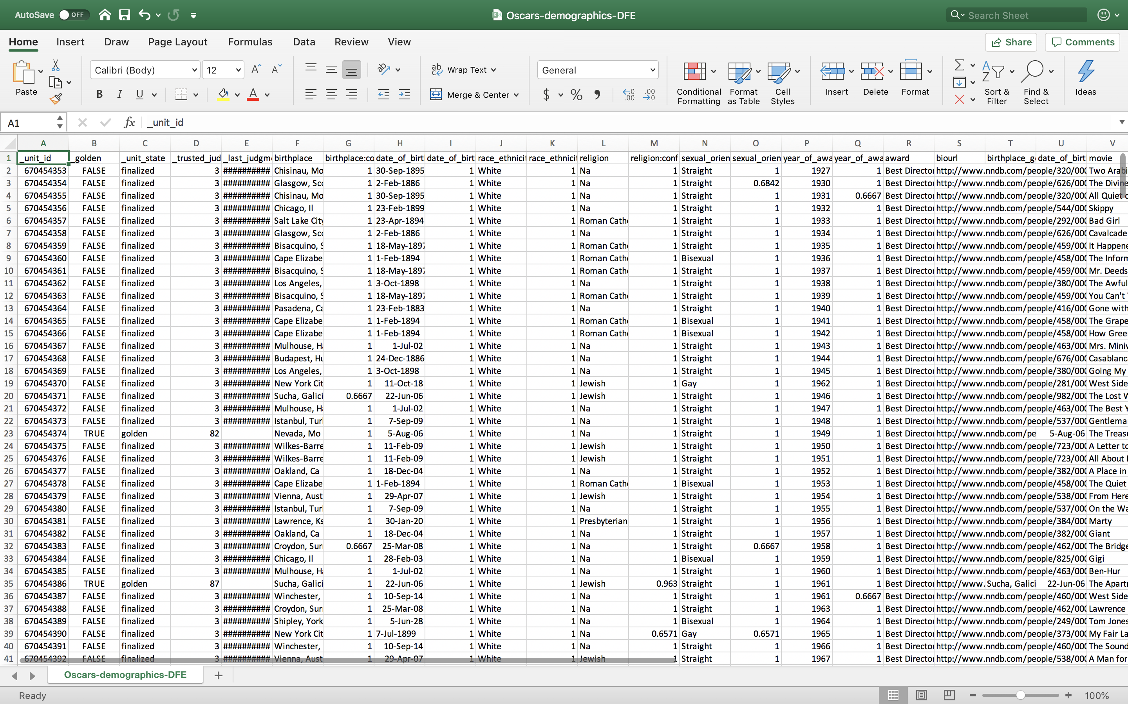
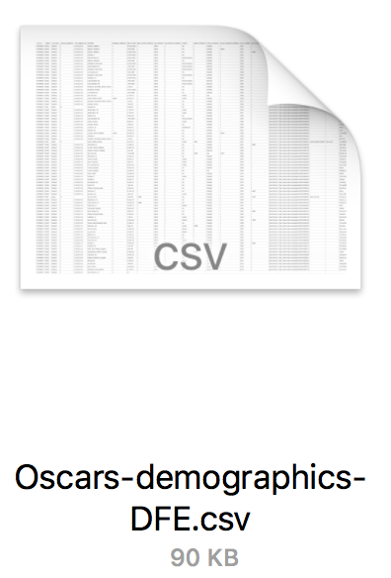
DATA DESCRIPTION
(441,27)

Slide 4
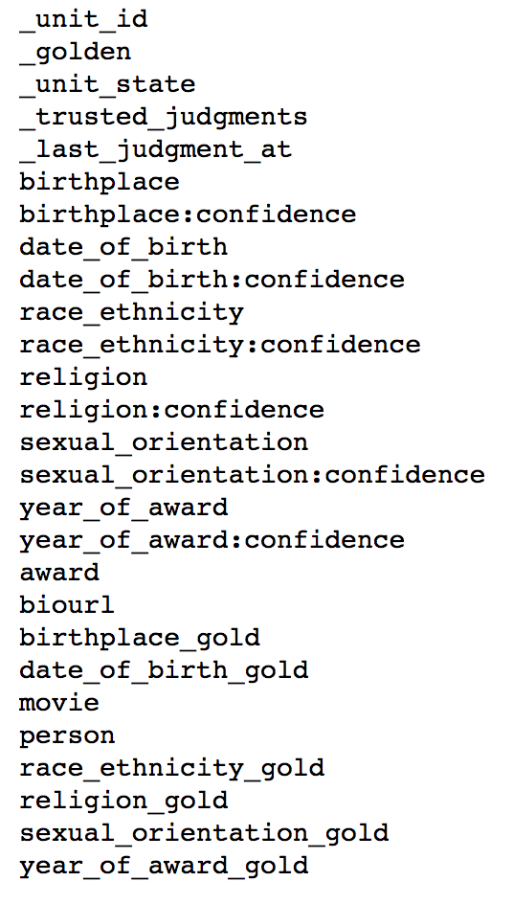
DATA DESCRIPTION
Data types
NUMERICAL
Continuous : _unit_id, _last_judgement_at_ , birthplace:confidence, date_of_birth, date_of_birth:confidence, race_ethnicity:confidence, religion:confidence, sexual_oridentation:confidence, year_of_award:confidence, year_of_award_gold
Discrete: _trusted_judgements, year_of_award
CATEGORICAL
Nominal : _golden, _unit_state, birthplace, race_ethnicity, religion, sexual_oridentation, award, birthplace_gold, date_of_birth_gold, movie, person, race_ethnicity_gold, religion_gold, sexual_orientation_gold,
Free: biourl

Slide 5
DATA DESCRIPTION
Questions to answer
1. How diverse are the Oscars in terms of race & ethnicity?
2. How diverse are the Oscars in terms of gender?
3. Where are most of the winners from?
4. How likely is it to win both the Oscars and the Golden Globe?
5. Which month were most of the winners born in?
6. How old were they when they first won the Oscars?
7. How many people won more than once?

Slide 6
02
DATA PREPARATION

Slide 7
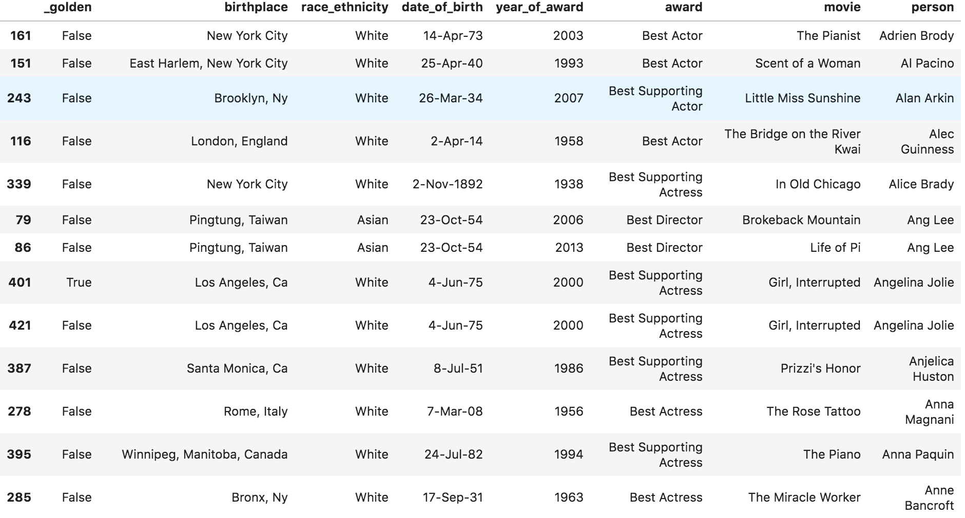
DATA PREPARATION
1. Construct a new data frame that contains only the columns of interest

Slide 8
DATA PREPARATION
1. Construct a new data frame that contains only the columns of interest

Slide 9
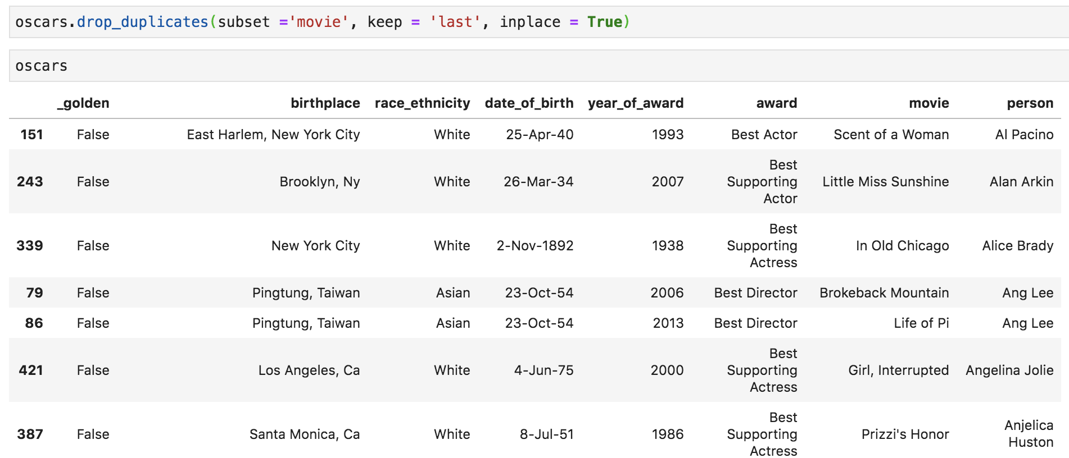
DATA PREPARATION
2. Remove the duplicated rows
.drop_duplicates()

Slide 10
03
DATA ANALYSES

Slide 11
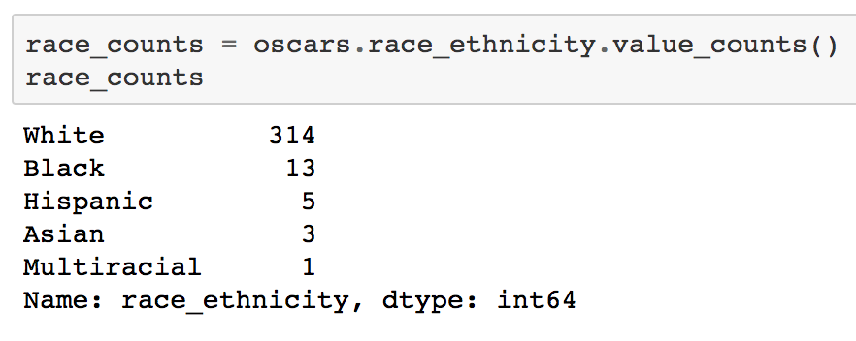
DATA ANALYSES
1. Oscars Winners by Race and Ethnicity

Slide 12
DATA ANALYSES
1. Oscars Winners by Race and Ethnicity
😱 Super racially skewed, right?

Slide 13
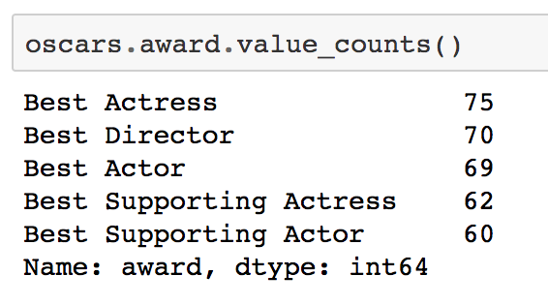
DATA ANALYSES
2. Oscars Winners by Award Category (Gender)

Slide 14
DATA ANALYSES
2. Oscars Winners by Award Category (Gender)

Slide 15
DATA ANALYSES
2. Oscars Winners by Award Category (Gender)
What is the sex ratio? 🤔

Slide 16
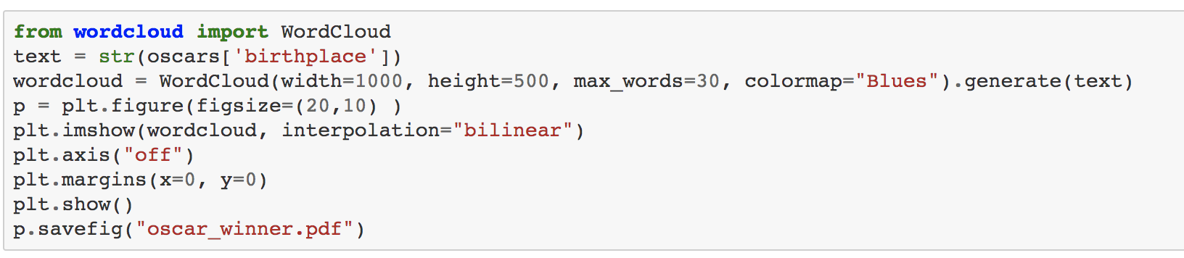
DATA ANALYSES
3. Where are most Oscars winners from?

Slide 17
DATA ANALYSES
3. Where are most Oscars winners from?

Slide 18
DATA ANALYSES
3. Where are most Oscars winners from?
England
London
New York
Brooklyn
Ca

Slide 19
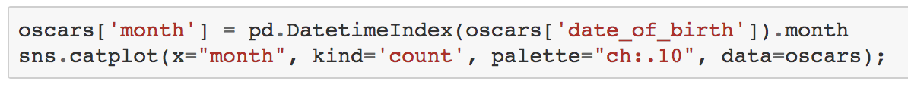
DATA ANALYSES
4. Which month were most Oscars winners born in?
.DatetimeIndex()

Slide 20
DATA ANALYSES
4. Which month were most Oscars winners born in?

Slide 21
DATA ANALYSES
4. Which month were most Oscars winners born in?
April
December

Slide 22
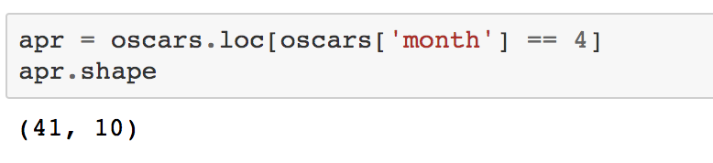
DATA ANALYSES
4. Which month were most Oscars winners born in?
April
December

Slide 23
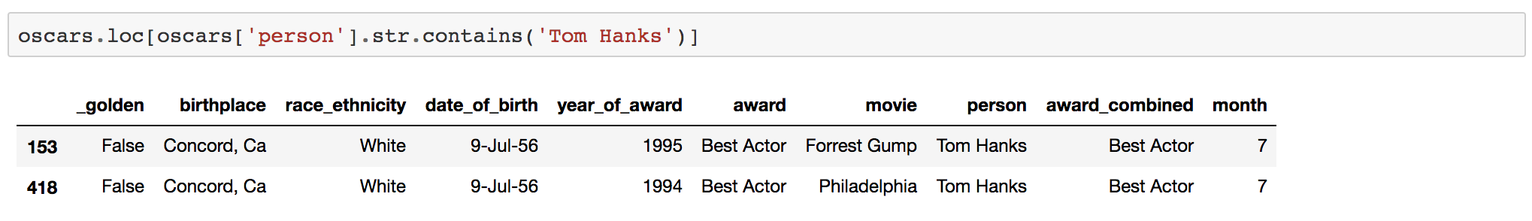
DATA ANALYSES
4. Which month were most Oscars winners born in?

Slide 24
DATA ANALYSES
5. What is the chance to win both the Oscars and the Golden Globe Award?

Slide 25
04
TAKEAWAYS

Slide 26
TAKEAWAYS
Visual Information-Seeking Mantra:
Overview first, zoom and filter, then details-on-demand.

Slide 27
TAKEAWAYS
Visual Information-Seeking Mantra:
Overview first, zoom and filter, then details-on-demand.
High Quality Data is the Key:
Data preparation is important, otherwise, you’ll like to encounter problems like data duplication, mixed formats of data, etc., later on.

Slide 28
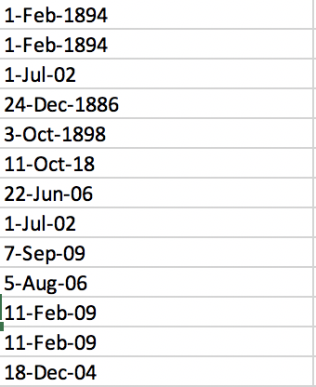
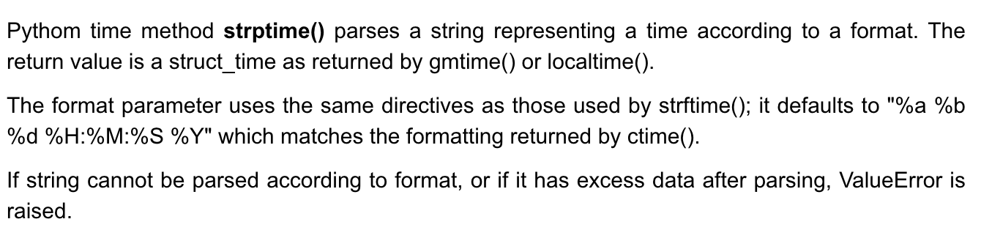
TAKEAWAYS
Visual Information-Seeking Mantra:
Overview first, zoom and filter, then details-on-demand.
High Quality Data is the Key:
Data preparation is important, otherwise, you’ll like to encounter problems like data duplication, mixed formats of data, etc., later on.

Slide 29
TAKEAWAYS
Visual Information-Seeking Mantra:
Overview first, zoom and filter, then details-on-demand.
High Quality Data is the Key:
Data preparation is important, otherwise, you’ll like to encounter problems like data duplication, mixed formats of data, etc., later on.
Use Visualization Across Data Analyses:
Not just to communicate your findings and results, but also a way to explore the dataset.

Slide 30
THANKS!

